Slide 1
Mark Community Land Trust
Welcomes You
Thank you for attending
Mark Community Land Trust
The community working together for the future of the village

Slide 2
Mark Community Land Trust
Community Meeting
11th September 2015
Affordable Homes for Local People
Mark Community Land Trust
The community working together for the future of the village

Slide 3
Agenda
  Welcome and housekeeping - Simon Emary
  Purpose of Meeting - Simon Emary
  Introductions - Simon Emary
  Overview of Housing Needs Survey - Debbie Jull, Sedgemoor DC
  What is a CLT and what can it do? - Geoff Francis
  Structure, Benefits & Membership of a CLT - Mike Schollar
    Questions
  Mark CLT’s First Project - Jan Horn
  Site Search Overview - Jan Horn/Simon Emary/Mike Schollar/Geoff Francis
    Questions
  Community Vote
  Conclusion, next steps

Slide 4
Welcome
Housekeeping
Purpose of meeting
Ground Rules
Simon Emary
MCLT – Chairman
Notes:
Thanks for attending
What the meeting is trying to achieve – We want to inform the community and seek their support for a development of affordable rented housing for local people from Mark or with a strong connection to Mark
4 members of Mark Community Land Trust (CLT) will present and inform you about the project
After presentation sections there will be an opportunity for you to ask questions. I suggest each questioner talks for a short time precise and to the point
We are anxious that you are fully informed. Questions with a similar theme can be linked together suggest only one question per person so we can give as many people as possible to ask questions and then come to understand what we are trying to do
Refer to logo its for our community
Later on we will be asking for your support

Slide 5
Introductions
  Steve Watson, Wessex CLT Project
  Alison Ward, Wessex CLT Project
  Debbie Jull, Sedgemoor District Council
  Simon Emary, Chairman MCLT
  Jan Horn, Founder Member MCLT
  Geoff Francis, Deputy Chair MCLT
  Hattie Stevens, Founder Member MCLT
  Mike Schollar, Secretary MCLT
  Sally Flack, Founder Member MCLT (Apologies for absence)
  John Spencer, Treasurer MCLT (Apologies for absence)

Slide 6
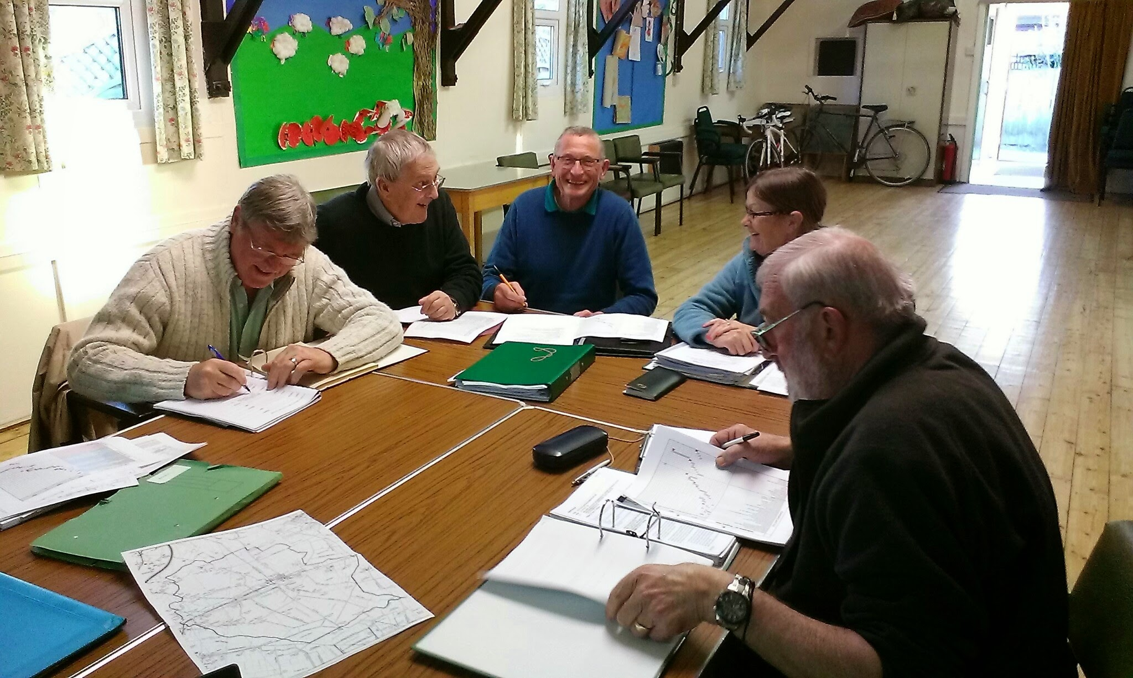
Mark Community Land Trust

Slide 7
Sedgemoor DC
Overview of
Housing Needs Survey
Debbie Jull
Sedgemoor District Council
Notes:
Debbie is part of the Affordable Housing Group at SDC
Duncan Harvey is the Affordable Housing Policy & Development Manager

Slide 8
The Housing Needs Survey
Results
In October 2013, a Housing Needs Survey was carried out by Sedgemoor District Council. There were 118 responses.
Resulting report published in March 2014, presented the following findings
  10 households with a strong connection to the parish were found to be in need of affordable housing.
  13 more households with a connection to Mark were registered with the Council.
  A variety of accommodation requirements were identified, ranging from 1 bedroom through to 3 bedroom properties.

Slide 9
The Facts
The housing need survey shows there is a definite requirement for affordable housing in Mark
Affordable housing allows local people to access a suitable home, at a price they can afford, where they were born / grew-up / have support and social networks or work
Currently only 5.1% of the housing stock in Mark are affordable homes. No new affordable homes have been built for 10 years

Slide 10
The Facts
We need HOMES FOR LOCAL PEOPLE at affordable rents now and in the future
Local rents are high
Younger Mark residents especially, have to move away
Priority for new affordable homes safeguarded by legally binding allocation agreement associated with the planning permission (s106)
Suggested that 12 affordable homes for rent required: 4 x 1 bed houses, 4 x 2 bed houses, 2 x 3 bed houses & 2 x 2 bed bungalows

Slide 11
The Solution
Mike Schollar
MCLT

Slide 12

A community-led approach
Mark Parish Council wanted a community-led approach to providing affordable housing
Presentation by Wessex CLT Project to MPC on 20th Nov. 2014
MPC resolved to support the establishment of a CLT
Public presentation by the Wessex CLT Project on 20th Feb. 2015
Interested parties met on March 12th, Steering Group established
Mark Community Land Trust formed on May 26th this year

Slide 13
What is a Community Land Trust and what can it do?
Geoff Francis
MCLT

Slide 14
What is a Community Land Trust?
Not-for-private-profit organisation set up to benefit a specific community.
CLTs can own land and other assets which are important to a community – with an emphasis on affordable housing.
CLTs hold those assets so that they are available and affordable for future generations.
CLTs are about local people being in control of local assets
They aim to ensure communities remain sustainable

Slide 15
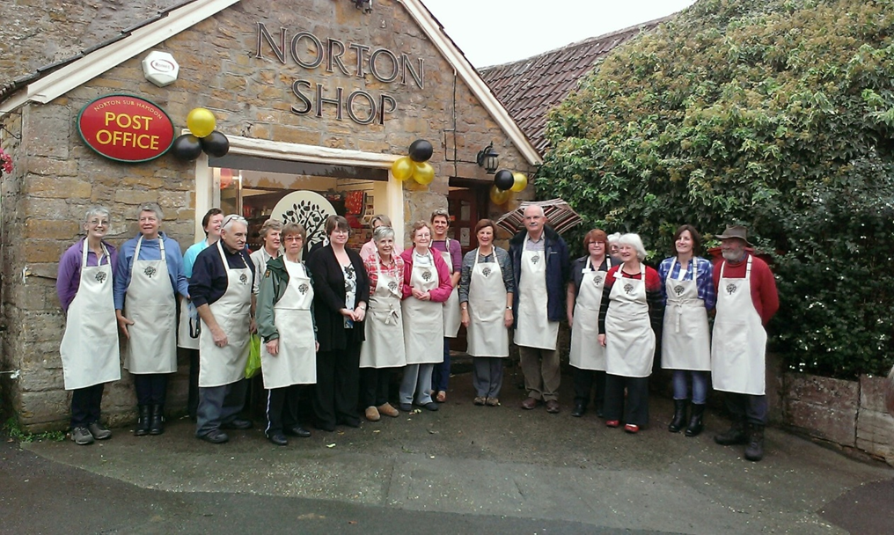

What can a CLT do?
Land / Affordable Homes
Pubs, Shops, Post-Offices
Develop new or existing services
Allotments
Office Space and Workshops
Car Parks
Renewable Energy Schemes
Notes:
You will note that there are many things a CLT can do on behalf of the community
YOU CAN THINK OF A CLT AS AN INSURANCE POLICY FOR THE FUTURE SO THAT THE COMMUNTY CAN REMAIN A VIBRANT PLACE TO LIVE WITH FACILITIES

Slide 16
Structure, Benefits and Membership of a
Community Land Trust
Mike Schollar

Slide 17
How is the CLT structured?
Community Benefit Society Registered with the Financial Conduct Authority
Anyone 16 or over who lives or works in the community and supports the aims of the CLT can join as a member and then vote on the activities of the society
The CLT is run by a board of directors – all members are eligible to stand for the board
Mark CLT must hold a General Meeting before November 2015, at which members will democratically elect a Board of Management
Mark CLT is affiliated to the National CLT Network and supported by the Wessex CLT Project

Slide 18
Benefits
Community led site selection
CLT input to the design of the development to ensure it is in keeping with its surroundings
CLT specifies the criteria for residence
Affordable homes for local people
New market rate schemes are not just for ‘local’ people whereas CLT schemes are!

Slide 19
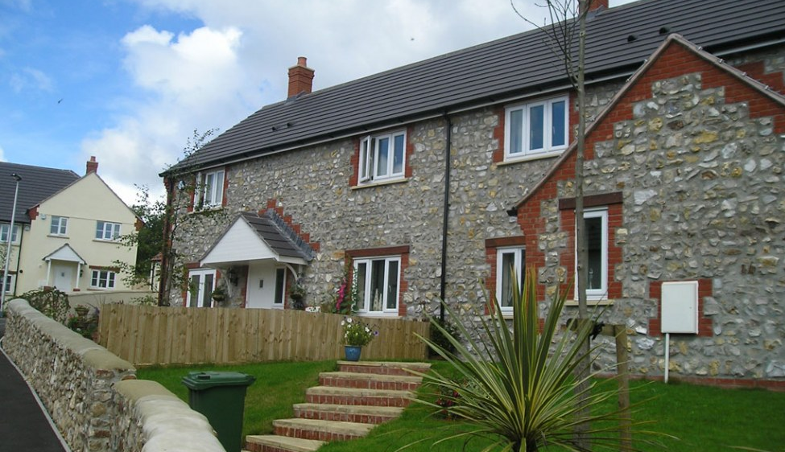
Upper Culm CLT and Hastoe Housing – Blackdown Hills

Slide 20
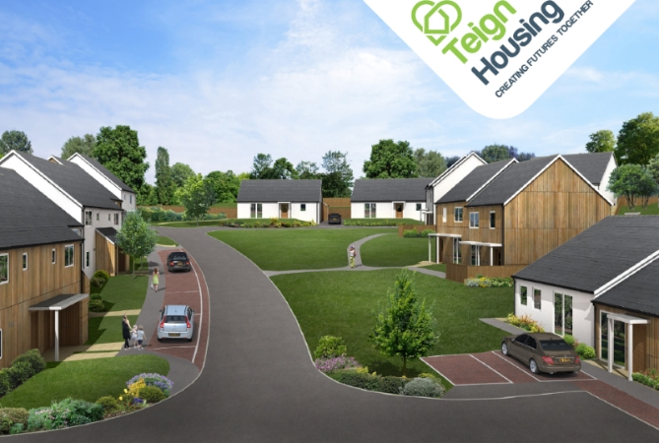
Christow CLT and Teign Housing - Dartmoor

Slide 21
Corry Valley CLT and Yarlington Housing - Devon

Slide 22
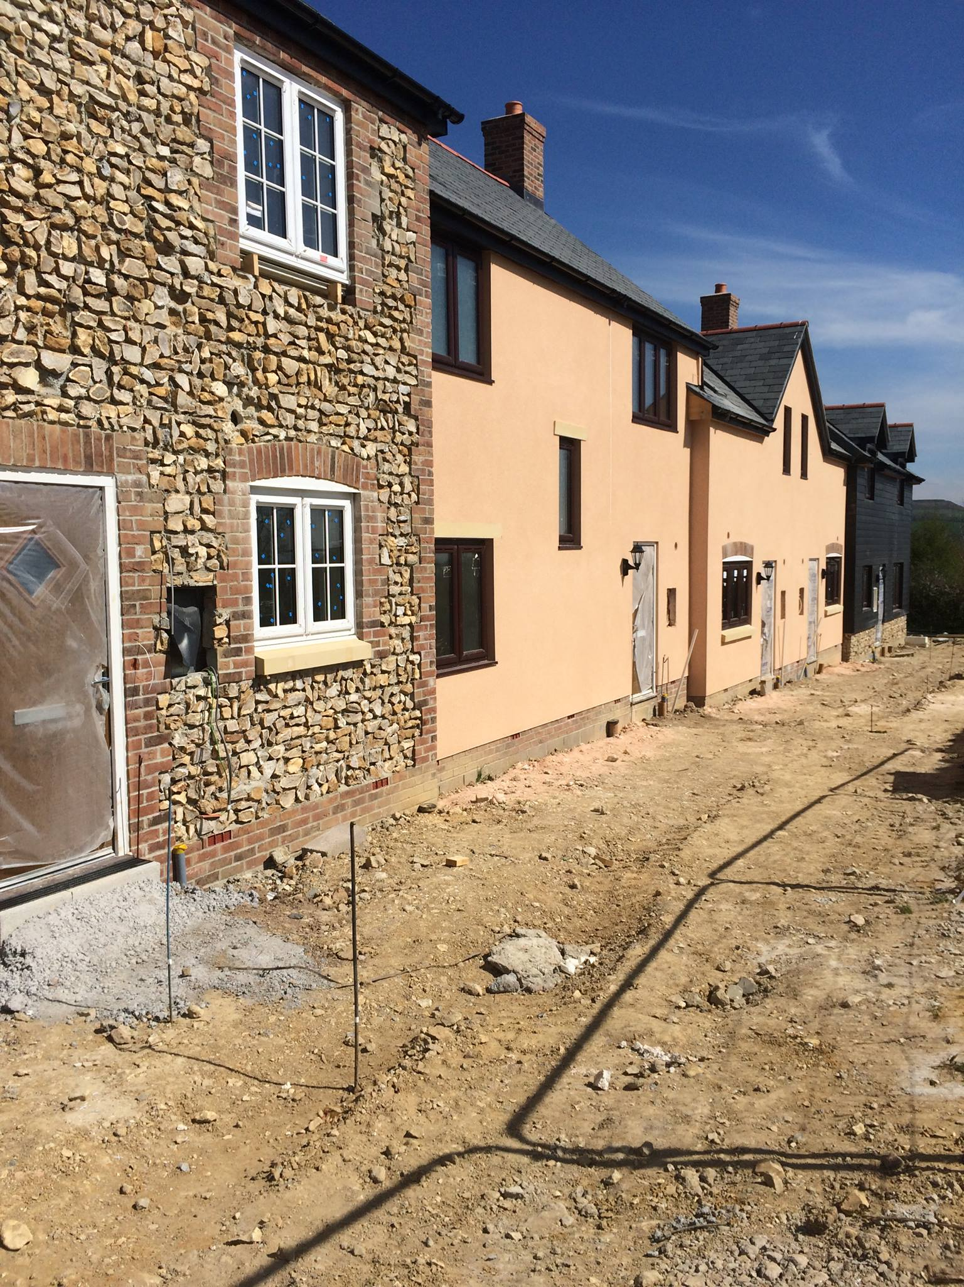
Marshwood CLT and Hastoe Housing - Dorset

Slide 23
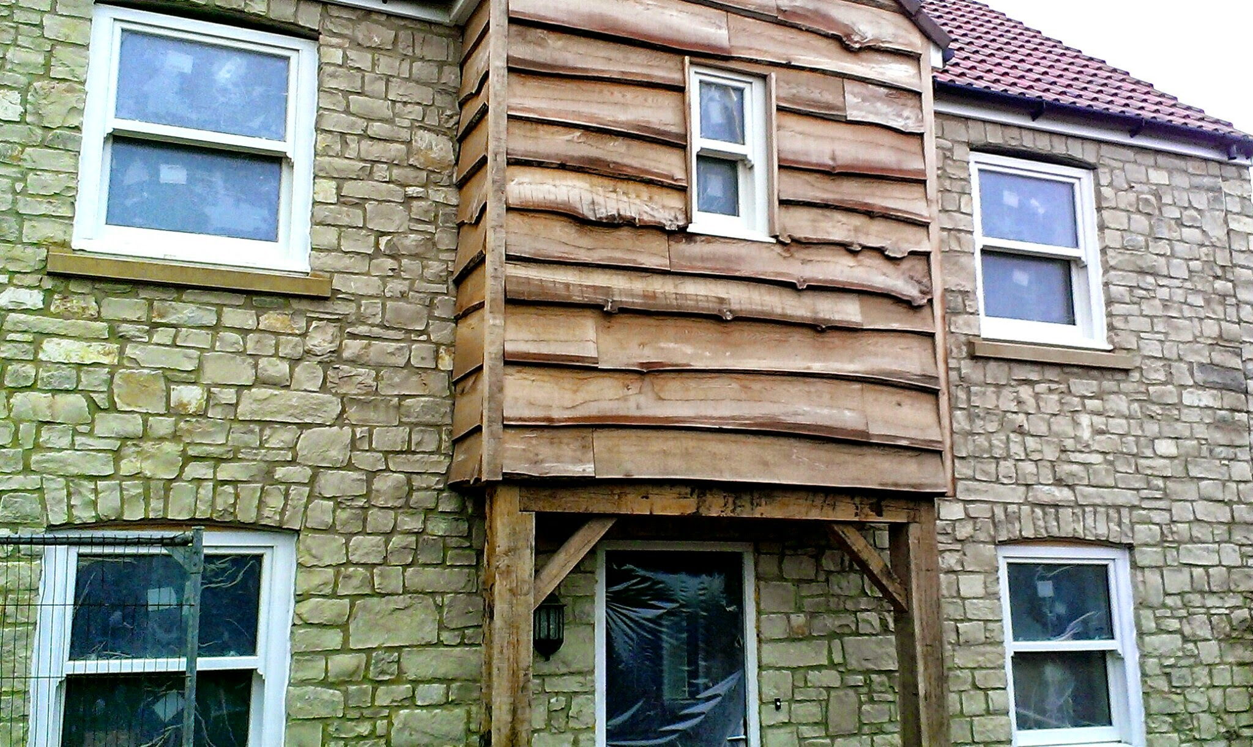
Queen Camel CLT and Hastoe Housing - Somerset

Slide 24
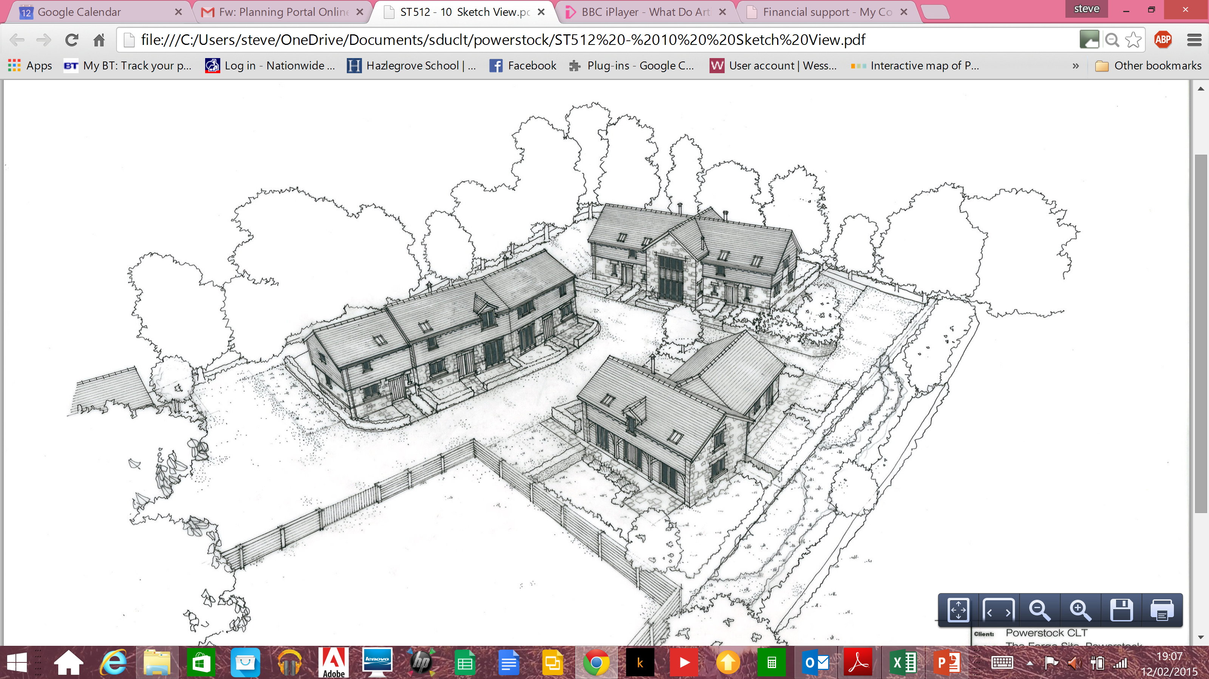
Powerstock and District CLT and Hastoe Housing - Dorset

Slide 25
Membership Invitation
Get involved in the provision of local services and affordable housing, have your say
Each member has one vote irrespective of the number of shares held
A single share costs just £1 – membership forms are available tonight
Rules of Mark CLT will be available on the Village website
Mark Community Land Trust
The community working together for the future of the village

Slide 26
Questions
Mark Community Land Trust
The community working together for the future of the village

Slide 27
Mark Community Land Trust
First Project
Affordable Housing
Jan Horn
MCLT

Slide 28
Mark CLT First Project
Affordable Housing
Mark CLT searches for suitable land and consults the community (today’s meeting).
Once an agreed site is identified, Mark CLT selects a housing association partner to work with.
Mark CLT will own the site and lease it to the housing association for 125 years. MCLT receives a ground rent.
Mark CLT uses a grant to appoint an architect and surveyors, and makes a planning application.
The housing association partner funds and builds homes, taking the development risks.

Slide 29
Who will the houses be for?
To be eligible, applicants must be registered on the Somerset Homefinder, the county housing register. This verifies their legitimate need for affordable housing.
Mark CLT, the Council and the housing association will jointly agree and approve the criteria for allocating the homes
The housing association allocates the homes in line with the agreed criteria
Agreed criteria form part of a Legally binding allocation agreement
Typical criteria are:
  (a) Has lived in the parish for the previous 5 years;
  Has a demonstrable strong local connection such as:
    any past periods of residence in the parish;
    permanent employment in the parish;
    Close immediate family living in the parish
Notes:
Affordable housing allows local people to access a suitable home, at a price they can afford, where they were born / grew-up / have support and social networks or work in
Typical criteria are:
Currently resident in the parish for previous five (5) years
Previously resident in the parish for a recent period
Permanently employed in the parish (other valuable contribution to the parish community?)
Close immediate family still living in the parish (parent, grandparent, children?)
Priority for new affordable homes safeguarded by legally binding allocation agreement associated with the planning permission (s106)
Mark CLT, the Council and the housing association will jointly agree and approve the criteria for allocating the homes

Slide 30
Site Selection
Jan Horn/Mike Schollar/Geoff Francis/Simon Emary

Slide 31
The Process
MCLT searched for land within the village development boundary (VDB)
Once it was established there were no suitable parcels within the VDB, parcels outside the VDB were considered, ‘Exception Sites’
For each site looked at, the CLT considered the following factors:
  Site Suitability
    Planning policy restrictions
    Physical problems or limitations
  Site Availability for Housing
    Did the land owner wish to dispose of their land to support the provision of affordable housing?
    No legal or ownership issues
  Site Achievability for Housing
    Economic viability
Notes:
Assessment Criteria 1: Site Suitability for Housing
Factors such as planning policy restrictions and limitations (designations, protected areas, existing planning policy and corporate, or community strategy policy), any physical problems or limitations (access, infrastructure, ground conditions, flood risk, hazardous risks, pollution or contamination), any potential Impacts (upon landscape features and conservation) and any environmental conditions
Assessment Criteria 2: Site Availability for Housing
A site is considered available for development, when, on the best information available, there is confidence that there are no legal or ownership problems, such as multiple ownerships, ransom strips, tenancies or operational requirements of landowners.
The key question asked under this assessment was a simple one. Did the land owner wish to dispose of their land to support the provision of affordable housing?
Assessment Criteria 3: Site Achievability for Housing
This is essentially a judgement about the economic viability of a site, and the financial capacity of the affordable housing provider to actually build the new homes. Factors such as any site preparation costs relating to any physical constraints, any exceptional works necessary, relevant planning standards or obligations, prospect of funding or investment to address identified constraints or assist development.

Slide 32
‘Rural Exception Site’ Explanation
Where it can be established there are no suitable, available sites within the VDB the law allows homes to be built on ‘exception sites’
An exception site is land that would not normally be given planning permission e.g. agricultural land just outside the defined development boundary
Such sites are only available where there is a demonstrable need for affordable housing by people with a local connection
Once the land is identified, the CLT can purchase and hold it in trust for the benefit of the community
Notes:
There strict rules which apply to development on exception sites
And Sedgemoor DC have policies in their Local Plan CORE STRATEGY to cater for this
Mark CLT will own the freehold of the land so will be able to control its use – Its a community asset
Any potential exception sites have to be considerd for financial constraints, development constraints, development costs

Slide 33
Site Options
11 sites were put forward by landowners when SDC asked for possible sites as part of the Local Plan for the District
Subsequently 5 further sites were considered by MCLT
Many of these sites were discounted during initial MCLT Steering Group meetings for various reasons e.g. poor suitability, commercial value, highway issues, development costs
Landowners of 4 sites were approached
Notes:
There were lots of factors to be considered when choosing a site – Part of it was a judgement of what is acceptable to the village
We might be wrong about what is acceptable that why we are here today
We sent the same written terms to the owners of the 3 of the sites we had discussions with and a meaningful discussion with the fourth

Slide 34
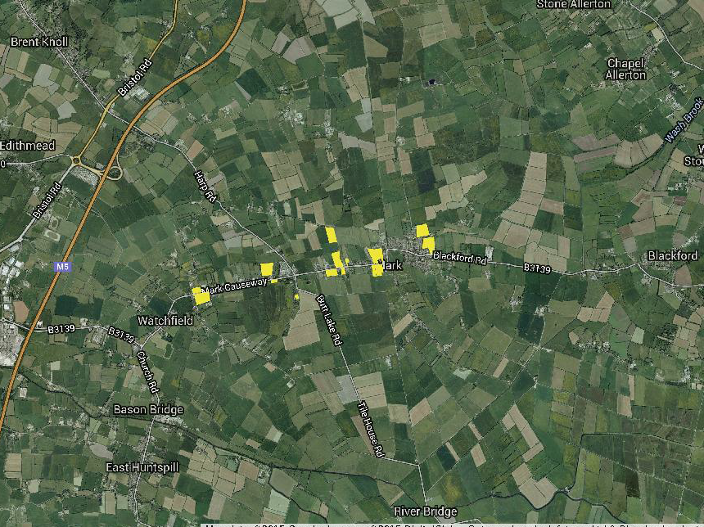
Notes:
This map shows all 16 sites from one end of mark to the other

Slide 35
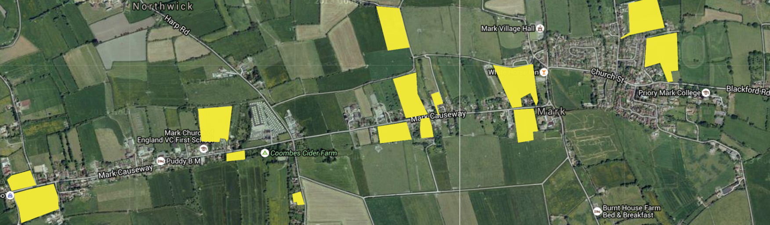
Notes:
A little bigger

Slide 36
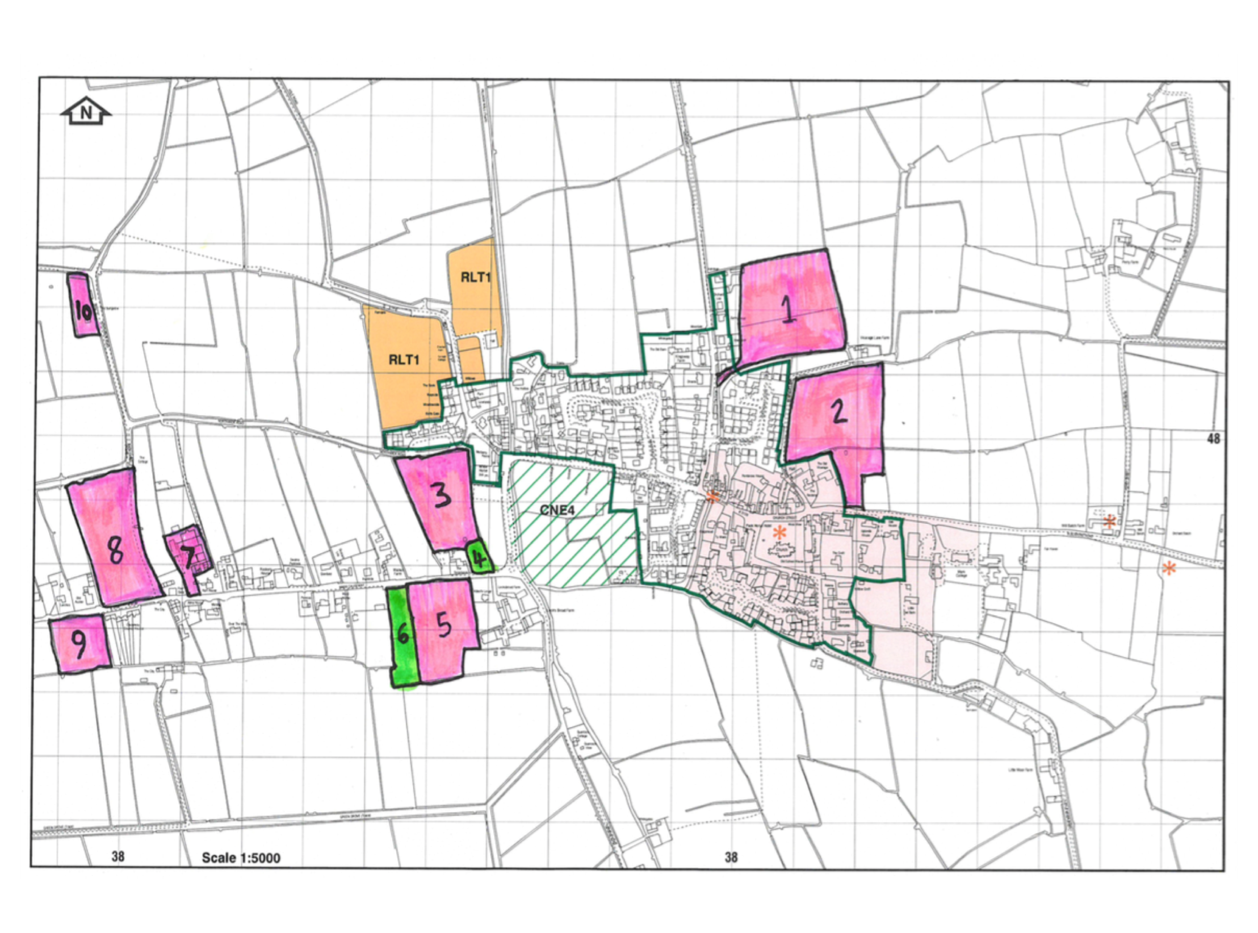
Notes:
These are maps produced by the Affordable Housing Group at SDC
Duncan Harvey is the Affordable Housing Policy & Development Manager

Slide 37
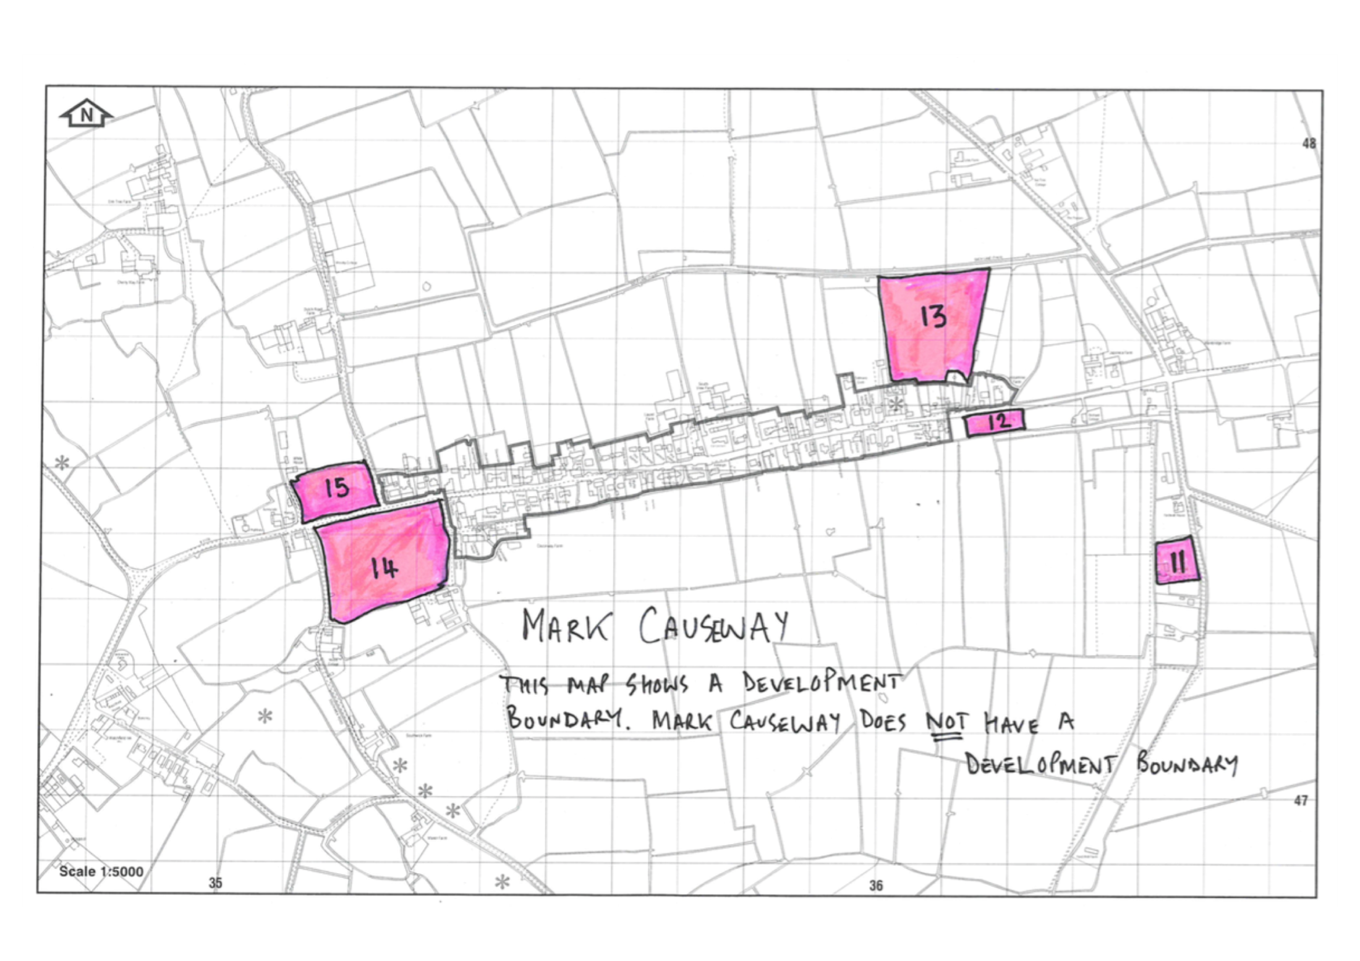

Slide 38
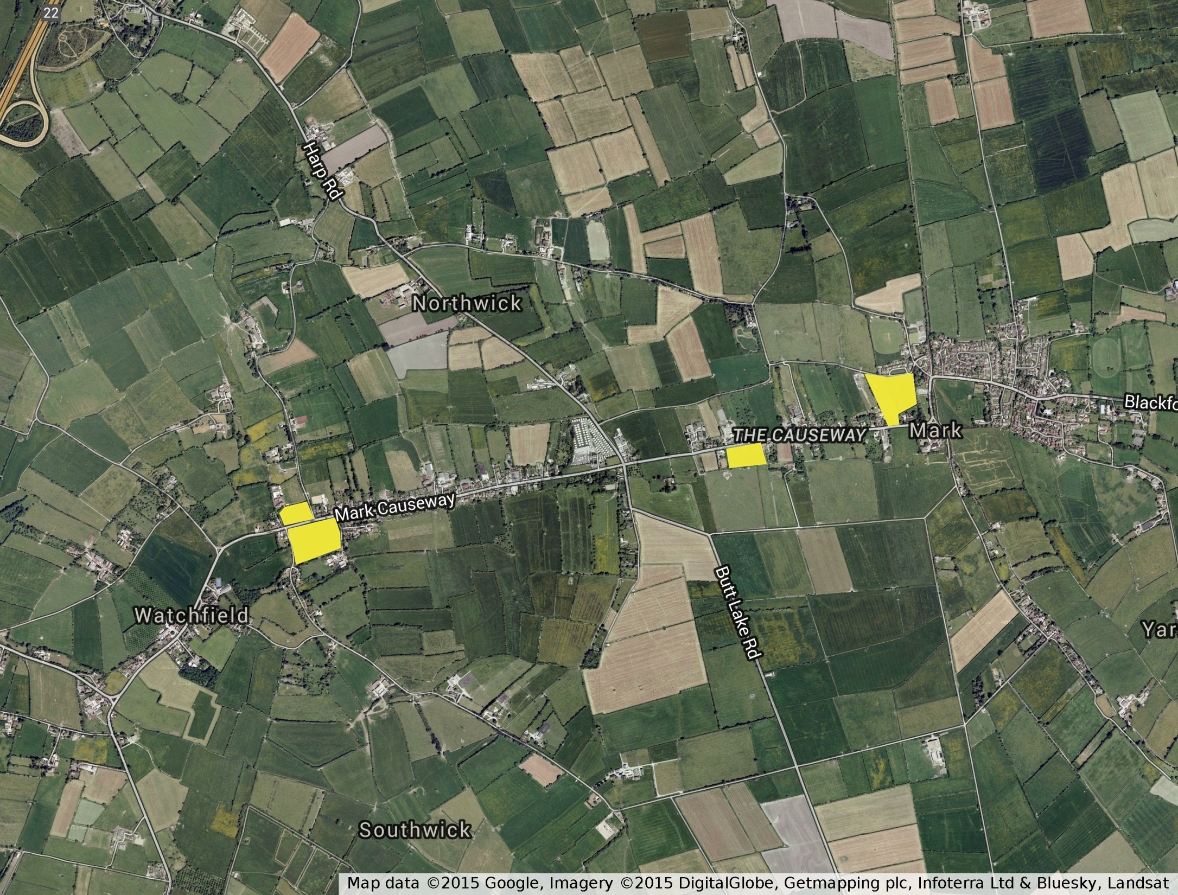

Slide 39
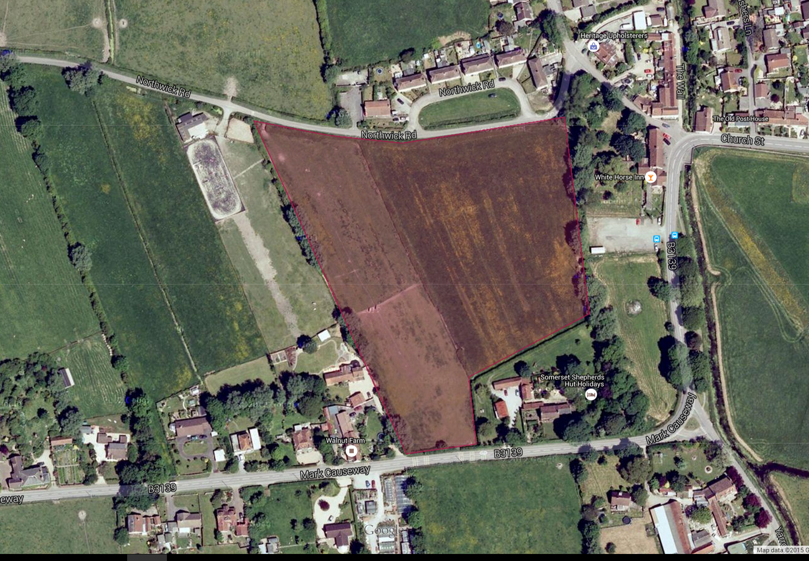

Slide 40
Why the Northwick Road site?
The site is easily accessible and not on a busy road
Adjacent to development boundary
Residents would be within easy walking distance of the village amenities, pubs, shop and the church. Mark school is a little more distant but not far away
It is available, the Landowner has indicated a readiness to sell the necessary amount of land. Unlike some other sites there is a clarity around whether the site can be purchased
Residents would feel part of the community and the community would be genuinely enlarged
  A mixture of twelve 1-bed, 2-bed and 3-bed homes are proposed, including two bungalows.

Slide 41
Questions
Mark Community Land Trust
The community working together for the future of the village

Slide 42
Community Vote
The time has come for your support.
– show of hands
Simon Emary

Slide 43
Proposal
‘Support the choice of the Northwick Road site as the preferred site for the development of 12 affordable rented homes’

Slide 44
Next Steps
Simon Emary

